Slide 1

CLIMB, the Cloud and Notebook Servers
Professor Mark Pallen

Slide 2
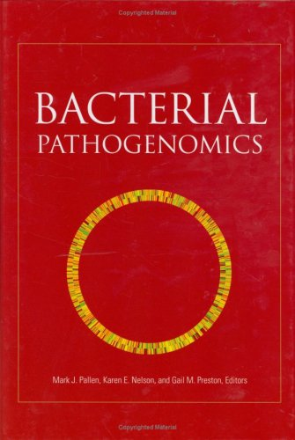
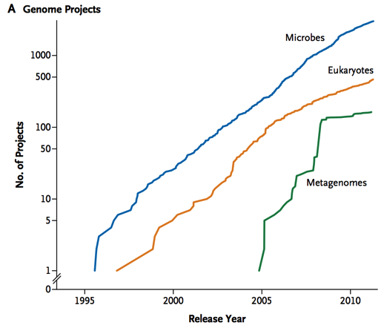
Bacterial Genomics The Golden Era: 1995-2007
Phase 1
Genome sequences from all significant bacterial pathogens of humans, animals and plants
Insights into pathogen biology
Phase 2
Multiple genomes from same species
Insights into genomic diversity

Slide 3
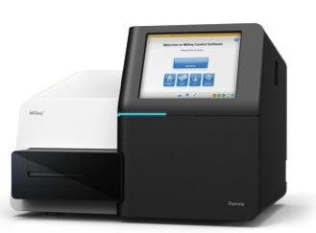
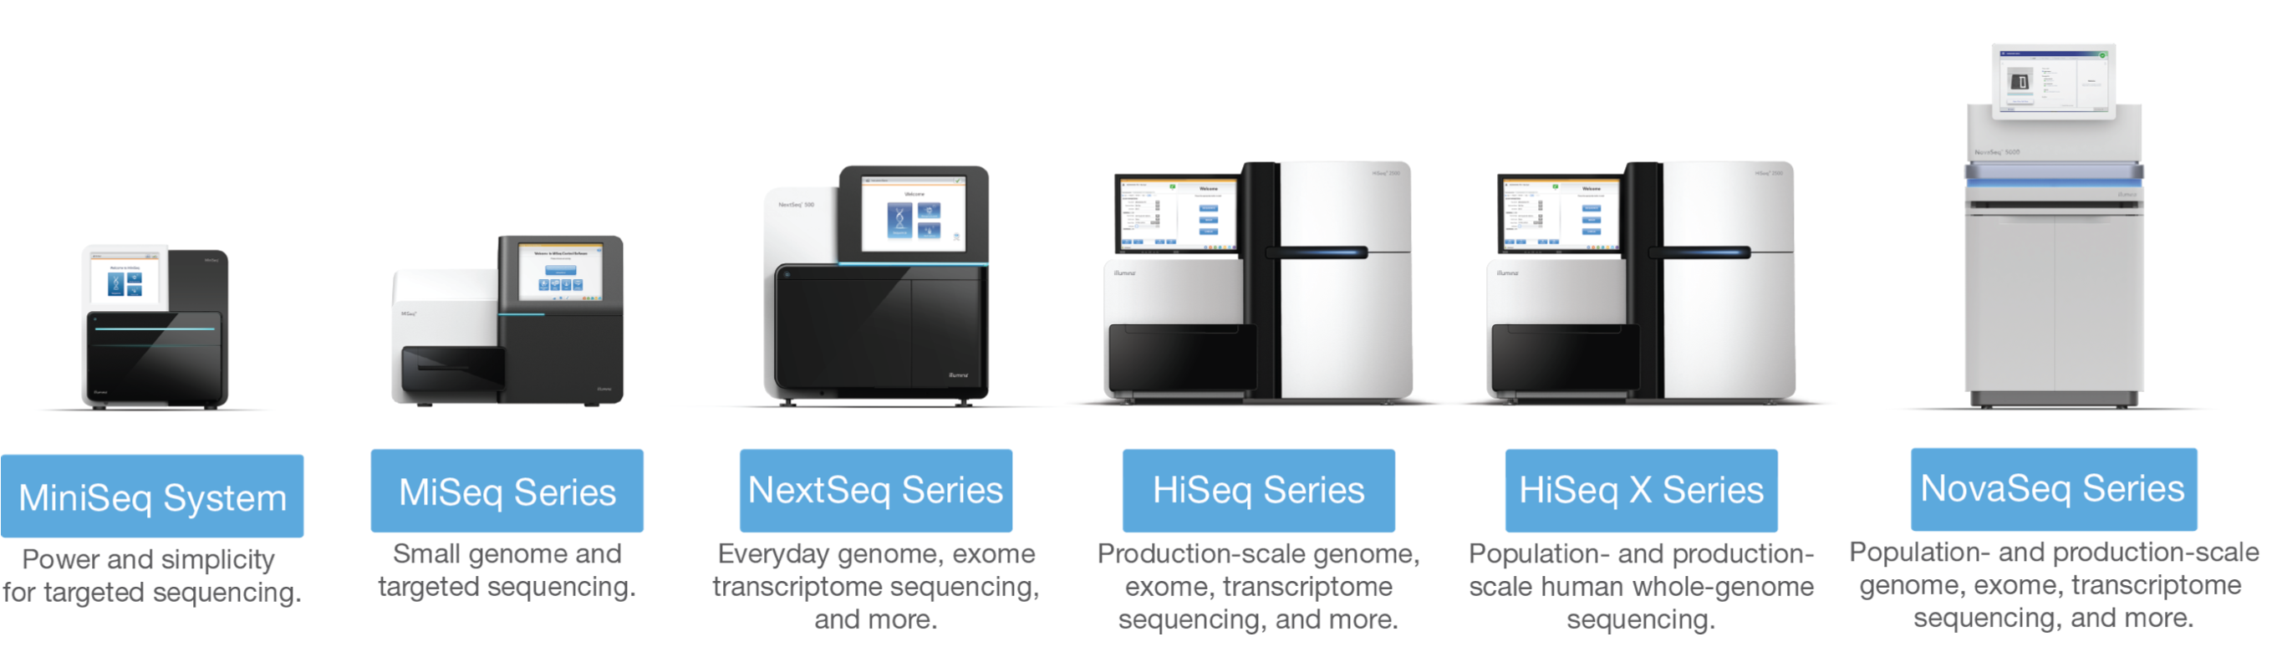
High-throughput Sequencing from 2007 onwards
>1000x faster, >1000x cheaper!
A disruptive technology
Bench-top sequencing easy, quick and cheap enough to have an impact on real-world clinical problems
Illumina short read sequencing

Slide 4

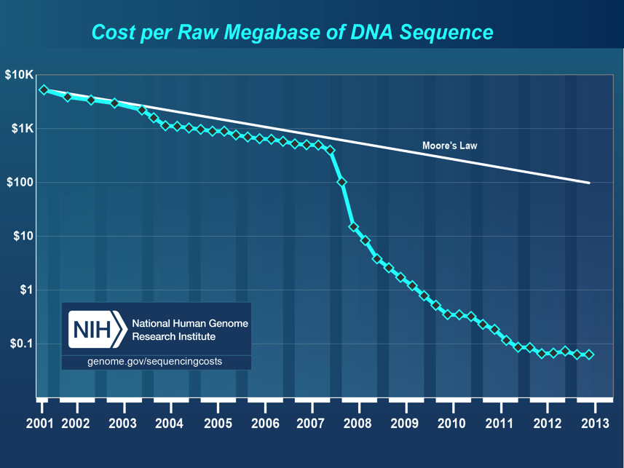
The Problems…

Slide 5

The Problem
Microbiologists in the UK are often unable to exploit large genomics datasets to address key questions in microbiology because they lack access to the relevant computational resources, bioinformatics tools or expertise in data analysis. We provide these resources.

Slide 6

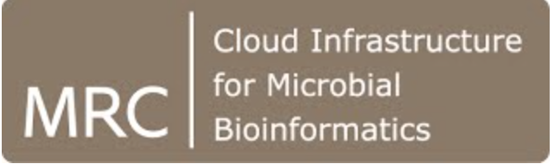
Enter the Cloud…
Cloud computing is efficient
Provides value for money
Removes hassle from end users
Cloud computing provides a mechanism for sharing data and pipelines
Allows standardisation
Enhances reproducibility
Saves research time
Makes training easier

Slide 7

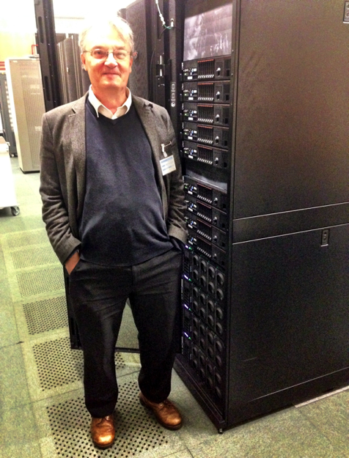
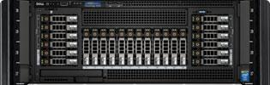
How does the Cloud work?
A user wants a server
The system spins up a virtual notebook server
a self contained ‘module’ containing
operating system and software
And slots it onto one of the servers
A user
A Datacentre
With many servers
and much storage
A user
One of the servers
A user
Other users also want systems
The Cloud OS will load those up too
Sharing a large server between users

Slide 8

MRC CLIMB (2013-2020) Cloud Infrastructure for Microbial Bioinformatics
Cloud Environment, root access to VMs, pre-installed OS
Warwick
Birmingham
Bryn
Virtual Computing Environment
OpenStack
Swansea
Cardiff

Slide 9
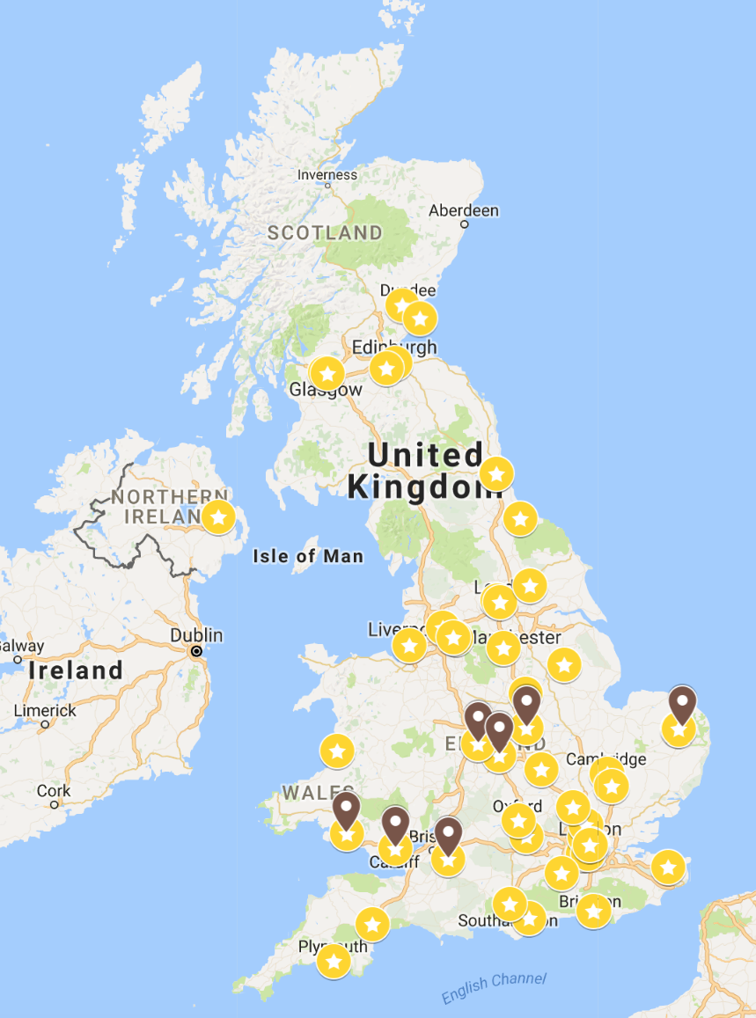

MRC CLIMB (2013-2020) Cloud Infrastructure for Microbial Bioinformatics
>900 users | >300 groups | > 85 institutions
>4,500 Virtual Machines fired up
>170 papers | £50M in funded projects
>40 events | >1,500 people trained
>38,000 views for 19 tutorials on Discourse
HPCwire Readers’ Choice Awards
Best use of HPC in Life Science
Best HPC Collaboration
https://tinyurl.com/climb-movie

Slide 10

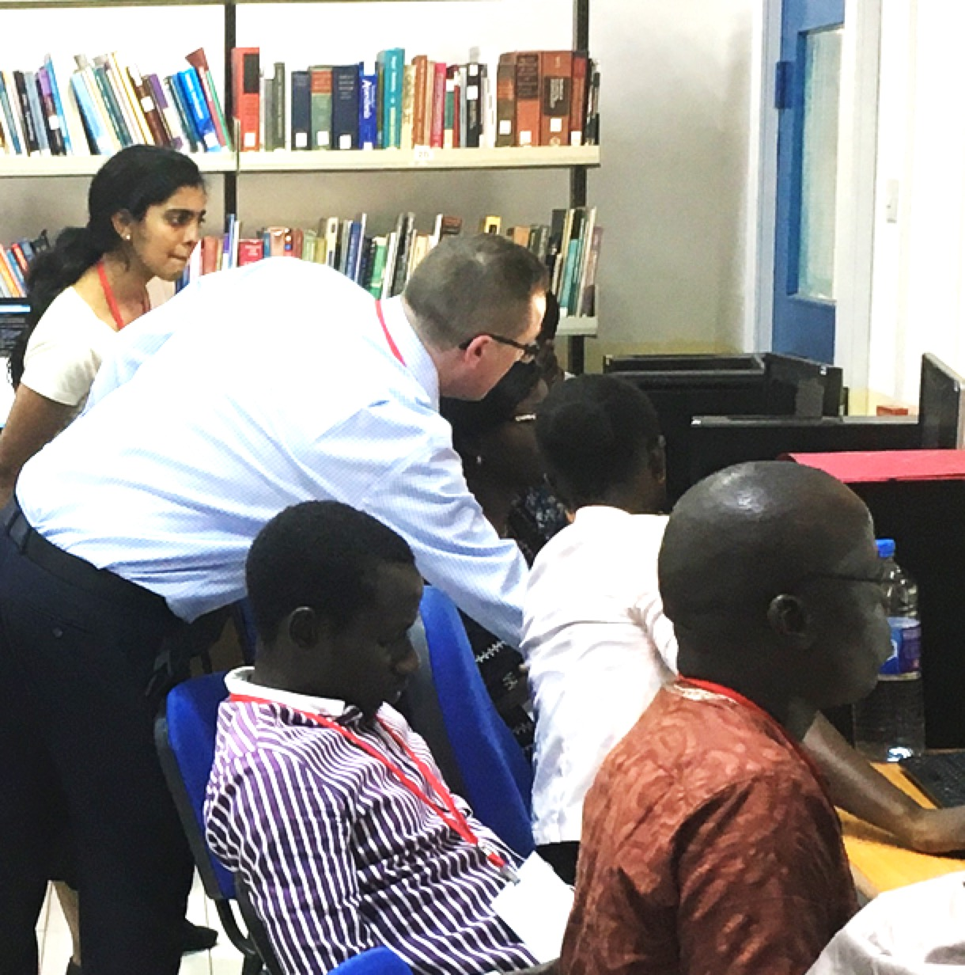



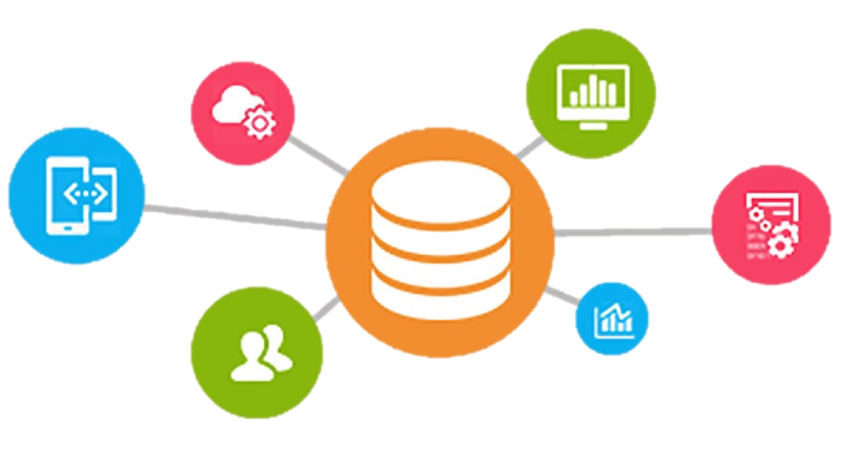







Community Engagement
Infrastructure
Symposia
Training
Graphics processing units
Enhanced storage
Hackathons
Software
Curation
Cloud-computing
Infrastructure
Workshops
Bacteria, Viruses,
Parasites, Fungi
Genomes, Metagenomes
Software
and data
Tools and Integration
Cloud Migration
Integration with external facilities
Support for public health
microbiology
Containers
Vibrant interdisciplinary team
with proven track record
Strategic Relevance
Sustainability
Expansion
Stable, resilient environment

Slide 11

CLIMB-BIG-DATA
Lisa Marchioretto
CLIMB-BIG-DATA Timeline
Business plan created
CLIMB has still a lot to give
CLIMB-BIG-DATA start
February 2020
May 2019
April 2020
September 2019
March 2020
April 2022
CLIMB-BIG-DATA grant proposal submitted
New usage model
Virtual champagne
In the middle the COVID pandemic

Slide 12
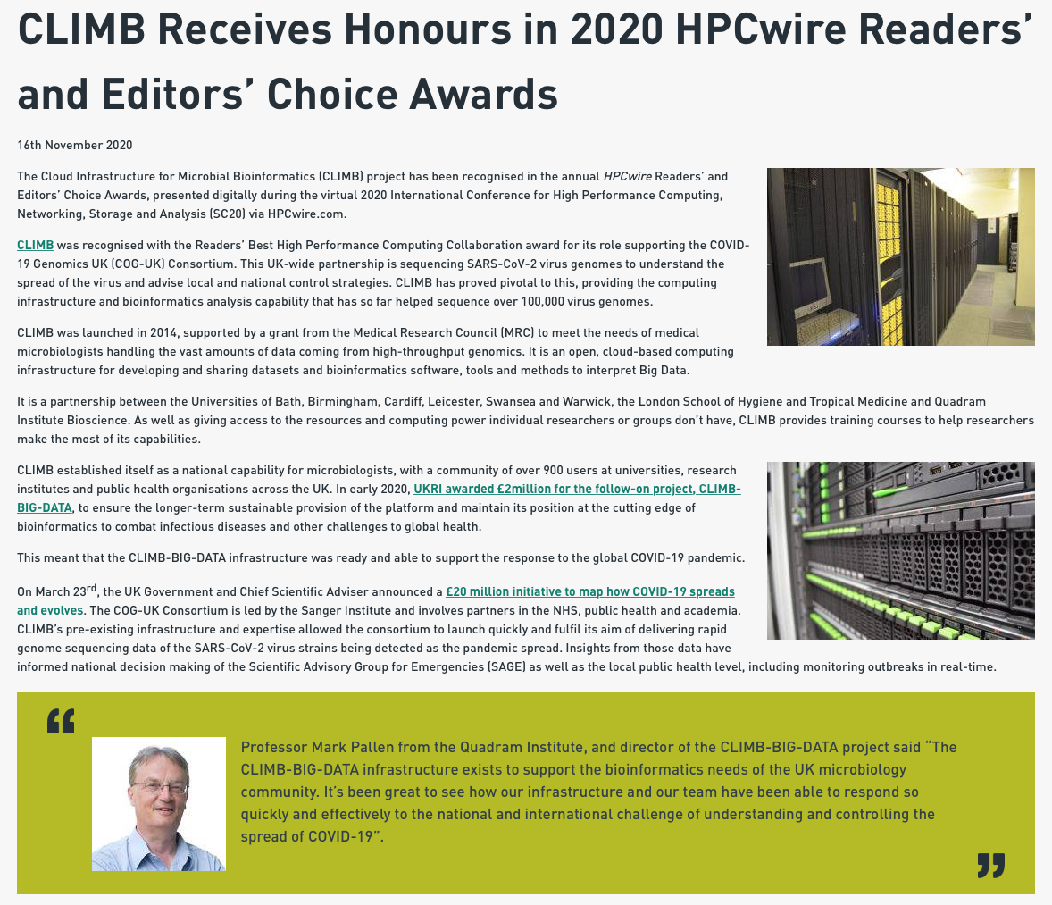
https://quadram.ac.uk/climb-receives-honours-in-2020-hpcwire-awards/

Slide 13


















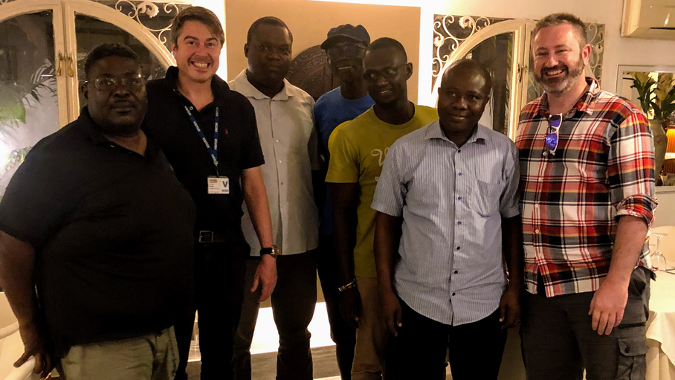



Team
Mark Pallen
QIB
Principal Investigator
Lisa Marchioretto
QIB
Project Manager
Mavis Foster-Nyarko
QIB
Project Manager
Michaela Matthews
QIB
User Support Manager
Andrew Page
QIB
Co-Investigator
Andy Millard
Leicester
Co-Investigator
Chris Quince
Warwick - EI
Co-Investigator
Martin Antonio
LSHTM
Co-Investigator
Andy Smith
Birmingham
Research Software Engineer
Nick Loman
Birmingham
Co-Investigator
Tom Connor
Cardiff
Co-Investigator
Sam Sheppard
Bath
Co-Investigator
Simon Thompson
Swansea
Co-Investigator
Anna Price
Cardiff
Research Software Engineer
Abdul Sesay
LSHTM
Genomics Expert
Charles Bedford
Cardiff
Cloud Computing Manager
Nabil-Fareed Alikhan
QIB
Bioinformatics Scientific Programmer
Richard Belton
Cardiff
Cloud Computing Manager
Thanh Le Viet
QIB
Bioinformatics Scientific Programmer
Archibald Worwui
LSHTM
Data Manager
Fran Terry
Swansea
Cloud Computing Manager
Radoslaw Poplawski
Birmingham
Cloud Computing Manager
Richard Stark
Warwick
Cloud Computing Manager

Slide 14
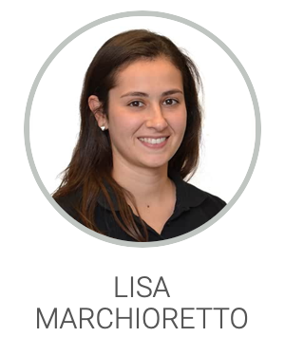
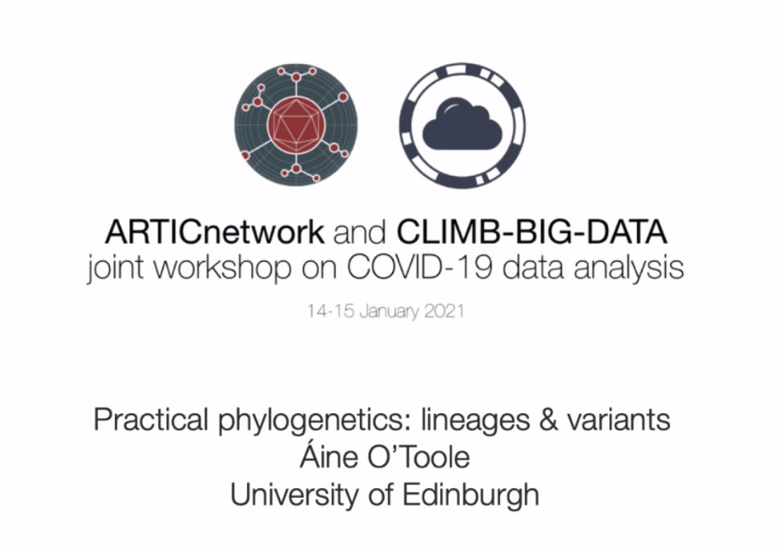
CLIMB-BIG-DATA Dashboard
Infrastructure
Users
Current usage
Expansion Cardiff Birmingham
QIB
Admin & Finance
Updated Ts&Cs
Database
Licencing system Primary Users
Every 3 months
Partnership
Team built!
Routine admin
Self-sustainability
COG-UK
CLIMB BIG DATA
Training
Security
Online
Beginners
Artic workflow
Hackathon
Best HPC collaboration (Academia, Government, Industry)
Service updates

Slide 15

What have we done?
01
Self-sustainability
03
Renewed user support
Costing model in place, several lines of income
Ticketing System, new Bryn interface, improved security, general email address
02
New usage model
04
Improved infrastructure
New image (with Conda/Mamba, Docker/Singularity and Workflow languages), Pipelines, Ephemeral VMs, Galaxy, RStudio, JupiterHub
S3 and Graphical Processing Units, Tools for enhanced sharing of Software and Data, Integration of the QIB

Slide 16
New Usage Model
Galaxy, RStudio, JupiterHub, Nextflow
Two-factor authentication
Combination of S3 and CEPH for storage
SLURM for scheduling
Singularity to manage containers
Bastion Server (Guacamole)
Nextflow to run containers
Paid and free tier

Slide 17
Jupyter Notebook Servers
allow you to create/manage Jupyter notebooks – interactive documents containing live code, equations, visualizations, and narrative text
facilitates interactive computing in several programming languages, predominantly Python.
provides a web-based interface, making it accessible from any browser, anywhere.
supports various kernels, enabling code execution in different programming languages.
integrates with several data science libraries and tools, enhancing functionality
enables multiple users to edit and run the notebook in real-time, promoting real-time collaboration

Slide 18
Rationale
offers an interactive environment, making it easier to test and debug code iteratively
supports rich outputs with HTML, images, videos, LaTeX, and custom MIME types
language agnostic: supports various languages, not limited to Python, such as R, Julia, and Scala
accessible from anywhere: being web-based, can be accessed remotely, facilitating distributed development
easy to share: can be easily shared among colleagues, supporting collaborative work
educational use: widely adopted for teaching coding and data science, due to its interactive nature

Slide 19
Advantages
provides a user-friendly, graphical interface, not just command-line
allows direct interaction with the code and immediate feedback, enhancing the development process.
supports integrated data visualizations, which conventional servers might lack.
documentation Integration: combines code with narrative text, facilitating documentation and explanation of the logic.
extensibility: offers a variety of extensions and widgets to enhance functionality, which might be limited in conventional servers.
accessibility and sharing: easy accessibility and sharing options make collaboration smoother compared to conventional servers.

Slide 20
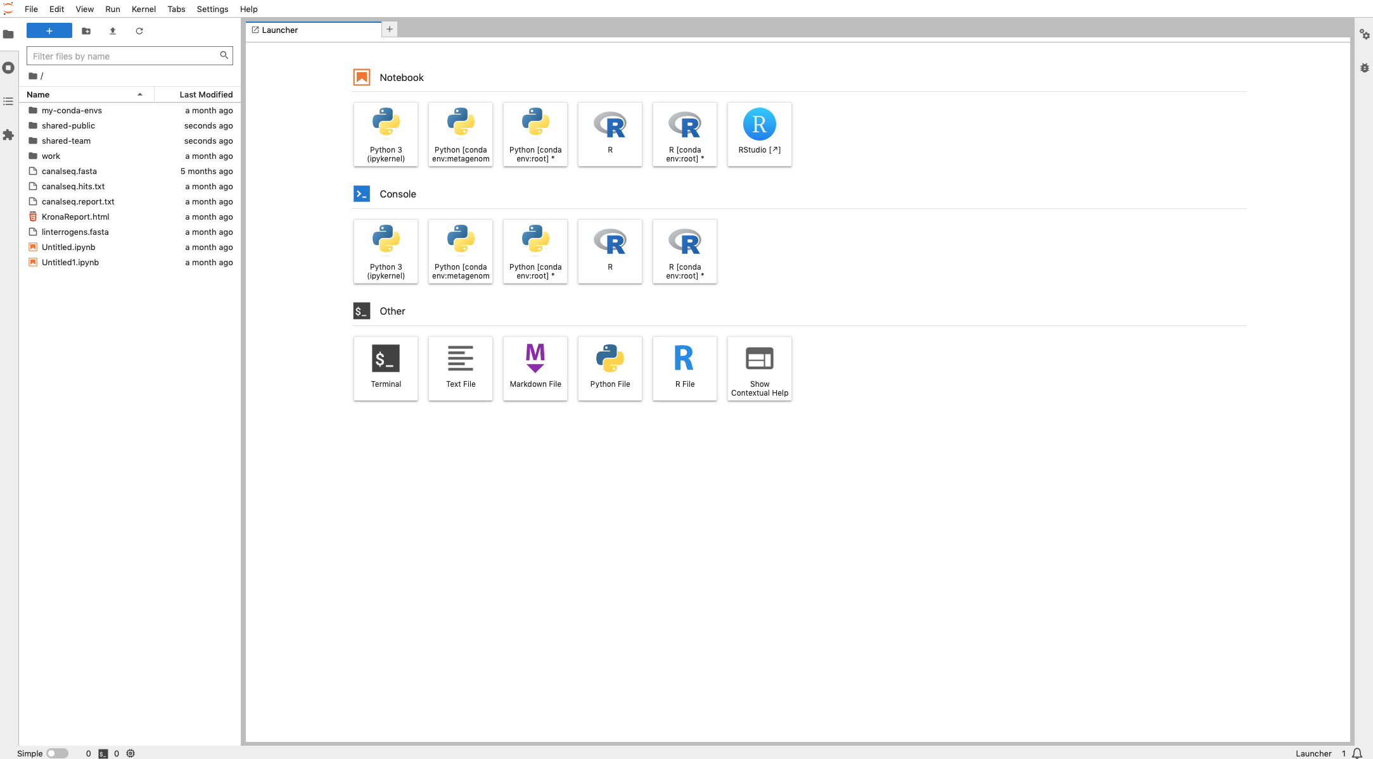


Slide 21
Advantages
lightweight: consumes less system resources compared to running a full VM, making it more efficient.
fast setup: Easier and quicker to set up and start, compared to configuring a VM.
offers real-time code execution and modification, unlike VMs.
seamless multi-language support within the same notebook, which can be cumbersome in VMs.
directly accessible through a browser, eliminating the need for remote desktop connections.
built-in tools for sharing and collaborative editing, which might require additional setup in VMs.

Slide 22
Over to the expert…

